Slide 1
E-commerce
Gaofeng Peng, Mingjun Chen, Zheyu Li, Zhengyang Sun

Slide 2

Agenda
Introduction and ETL
SQL questions
Classification Analytics

Slide 3
Introduction and ETL
The E-Commerce dataset contains 9 tables that contains information about customers, orders, products, and sellers.
Change data type
Zip code (Integer to String)
Survey date (String to Datetime)
Replace string
Geolocation City (São Paulo to Sao Paulo)

Slide 4
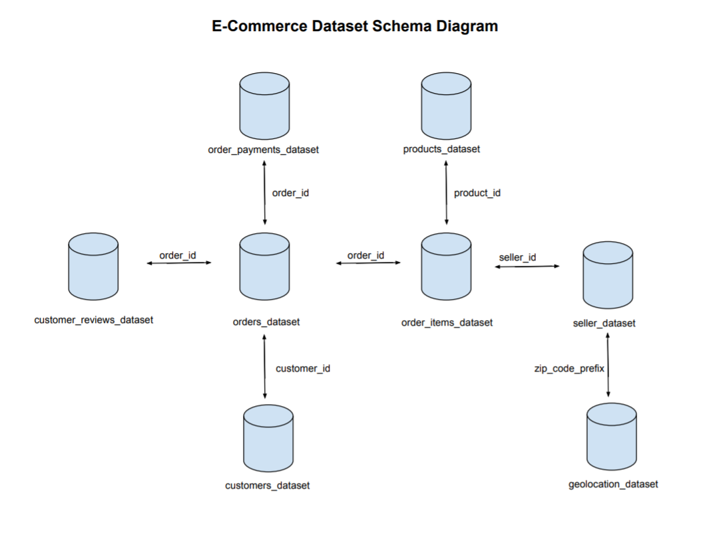
SQL Questions
Schema Diagram

Slide 5
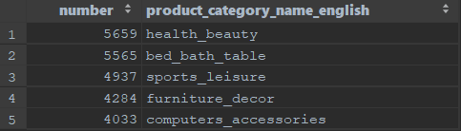
Question 1
Which category of products receive most 5 ratings (survey_score)?
Customer_Reviews
order_items
products
product_category_name_translation

Slide 6
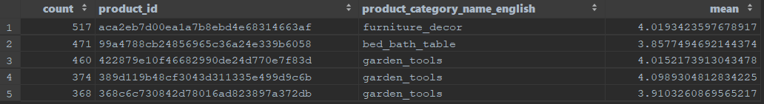
Question 2
What are the top 5 best selling products and what are their categories? What’s the average rating of each of these products?
products
order_items
product_category_name_translation
customer_reviews

Slide 7
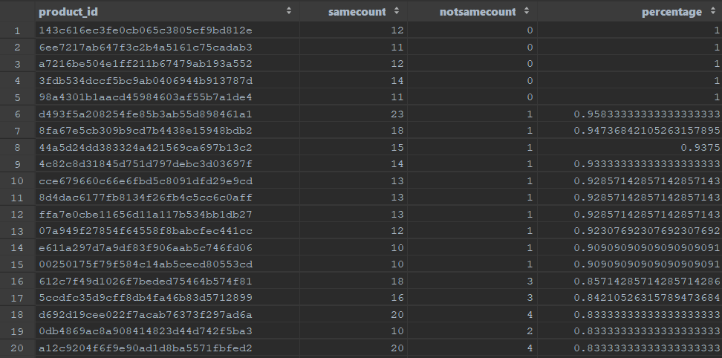
Question 3
For which products are the buyers and sellers mostly from the same state?

Slide 8
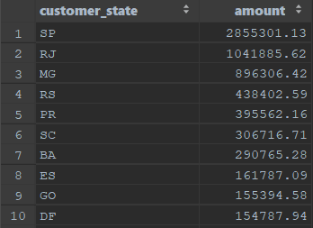
Question 4
Give a regional break-up of total sales of heavier (weighing at least 1 kilogram) products.
products
order_items
orders
customers

Slide 9
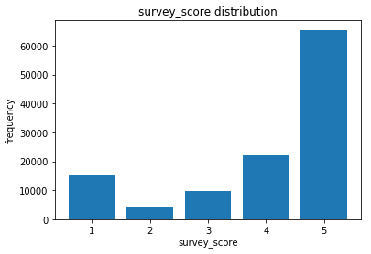
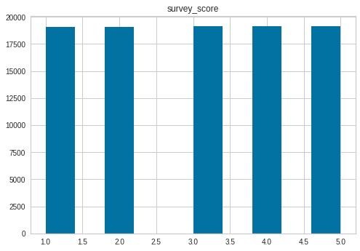
Multiclass Classification (3 classes and 5 classes)
Why interesting? Prediction,Interpretation
Data Preparation——Unbalanced data Clean Null data

Slide 10
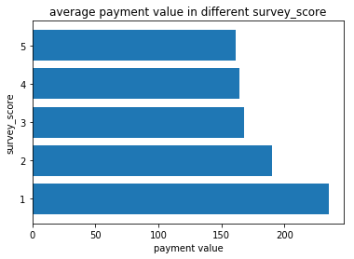
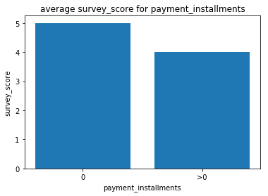
Exploratory Data Analysis Example

Slide 11
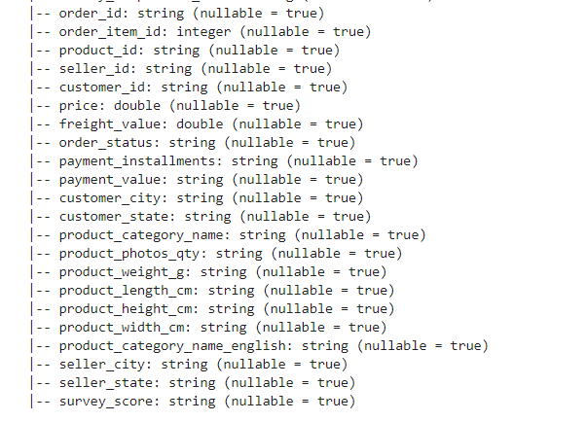
Data Description
One hot encoding features:
Seller_state,customer_state
order_status
Data type change :
From string to integer
Train set 70%,validation 30%
Test set :survey_score is Null

Slide 12
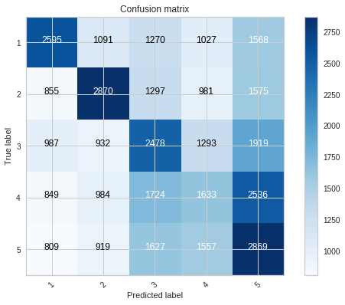
5 class prediction based on RDD using randomforest
numClasses = 5
numTrees=20, featureSubsetStrategy="auto", maxDepth=15,
impurity = "entropy"

Slide 13
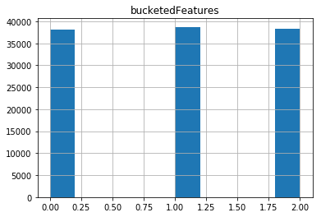
3 class prediction
Survey_score 1,2
Low class
Survey_score 3
Medium class
Survey_score 4,5
High class

Slide 14
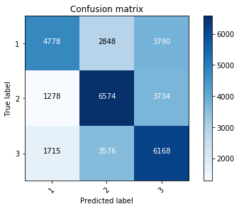
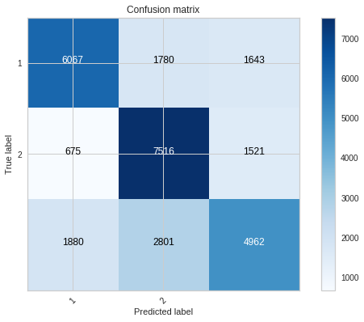
2 different algorithms of 3-class prediction
Rdd Random forest
numTrees=20, featureSubsetStrategy="auto" maxDepth=15
Grand acc=0.5
Pyspark Decision tree
Max depth 20
Grand acc 0.65

Slide 15
Importance Interpretation
Top 4 Important variable(not one hot)
1.Freight Value
2.Price
3.payment_value
4.payment_installments(encourage to pay for one time)
Top Important variable(one hot)
1.order status : Delivered(shorten delivery time)
2.customer_state : SP

Slide 16
Thank you

